Slide 1
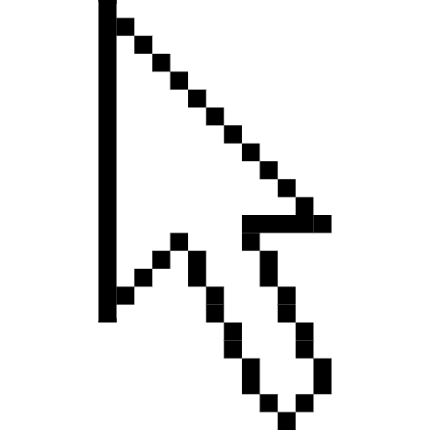
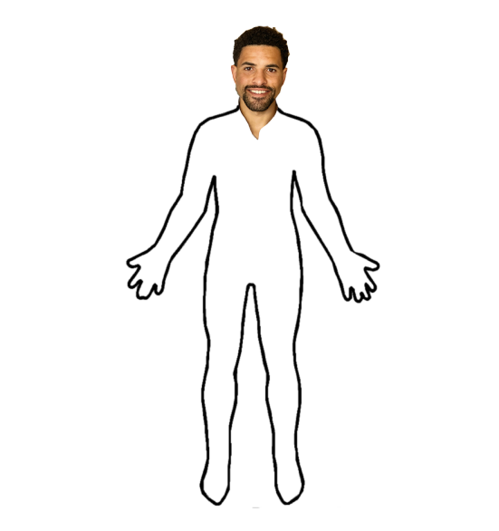
Temporary Team Name’s
Covid Clicker

Slide 2

Who are we?
Our client
James - Product owner, developer
Brillitte - Ethics manager, developer
Joseph - Scrum master, developer
Michael - developer
Notes:
State what you worked on

Slide 3
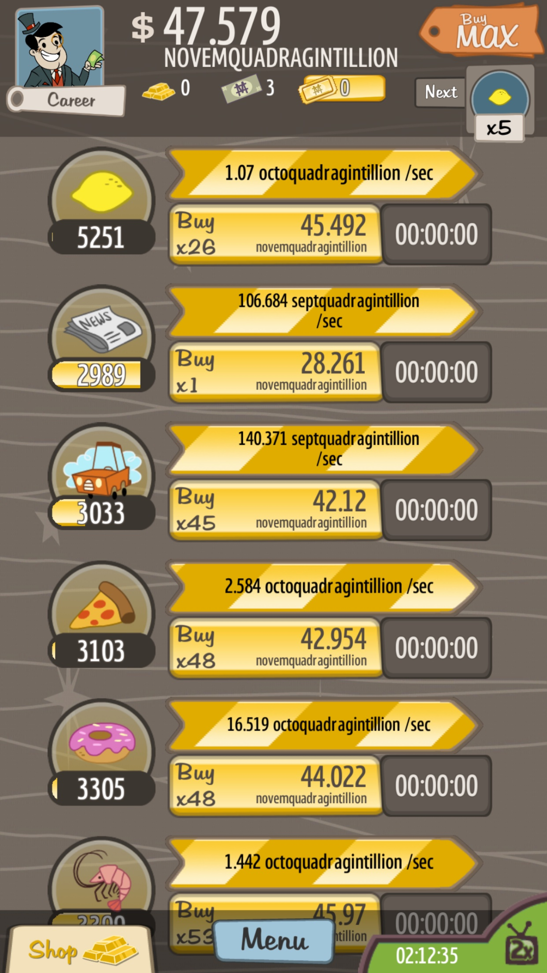
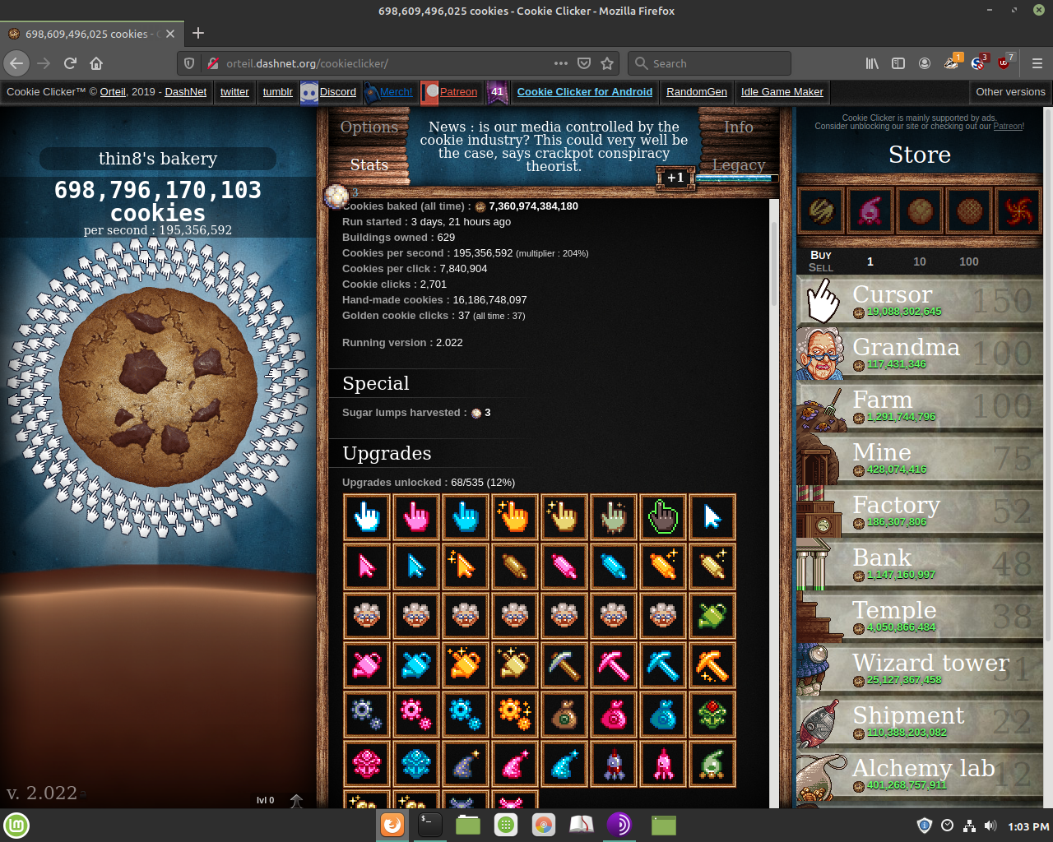
Background
What type of game did we make?
We made an incremental/clicker game!
What are the main parts of an incremental game?
Manual task for user earns points
Use points to buy items and upgrades to make points faster
Image from Happy Hippo / Kongregate
Image from Reddit / Orteil
Notes:
Boredom… everyone has experienced it. So, we decided to tackle this problem with a game, because who doesn't like games. The kind of game we decided to make was an incremental game. The basic concept of this kind of game starts off with the user performing a simple task like clicking a button to earn points. These points can be spent in 2 major ways. The first way is to buy items or objects that will produce these points for you, so you don’t have to click yourself. The second way is to buy upgrades for your existing producers to make them more efficient.

Slide 4
Key User Stories
As a user, I'd like to be able to start the game
As a user, I'd like to be able to buy cells
As a user I'd like to be able to upgrade my cells
As a user, I'd like to be able to see the game
As a user, I'd like to be able to see my current amount of DNA
As a user, I'd like to be able to see my current amount of DNA
Notes:
We felt that these were some of the most important user stories that gave us a direction to start making our game. As you can see, our first three basically dealt with the game’s operation. With the ability to make purchases, we knew we wanted a GUI with multiple buttons that bought different producers. Once we implemented the GUI and had all of the appropriate buttons in place, we started to add functionality to the buttons. By following this method of implementing buttons and adding functionality one step at a time, we eventually had a functioning game.

Slide 5
Our Design and Implementation
Notes:
What were the major classes implemented? Present a very basic UML class diagram that includes only the class names and important relationships! Make sure it’s readable by the listener! And more importantly, make sure you can clearly explain it! Keep unnecessary details out, such as fields and methods. Make a diagram that has only the class names, relationships between the classes. Include only those fields and methods that are an integral part of your design and are relevant for your presentation.
Any interesting data structures out of the ordinary? Discuss it!
The team is encouraged to use UML state and sequence diagrams to help discuss challenging parts of their design.
Did you use any advanced data structures of your own, or from the Java API? What were the major algorithms used? (e.g. if you implemented a computer player, how did you govern how the computer plays? Did you apply any AI algorithms? Or brute force? What rules did you use?)

Slide 6
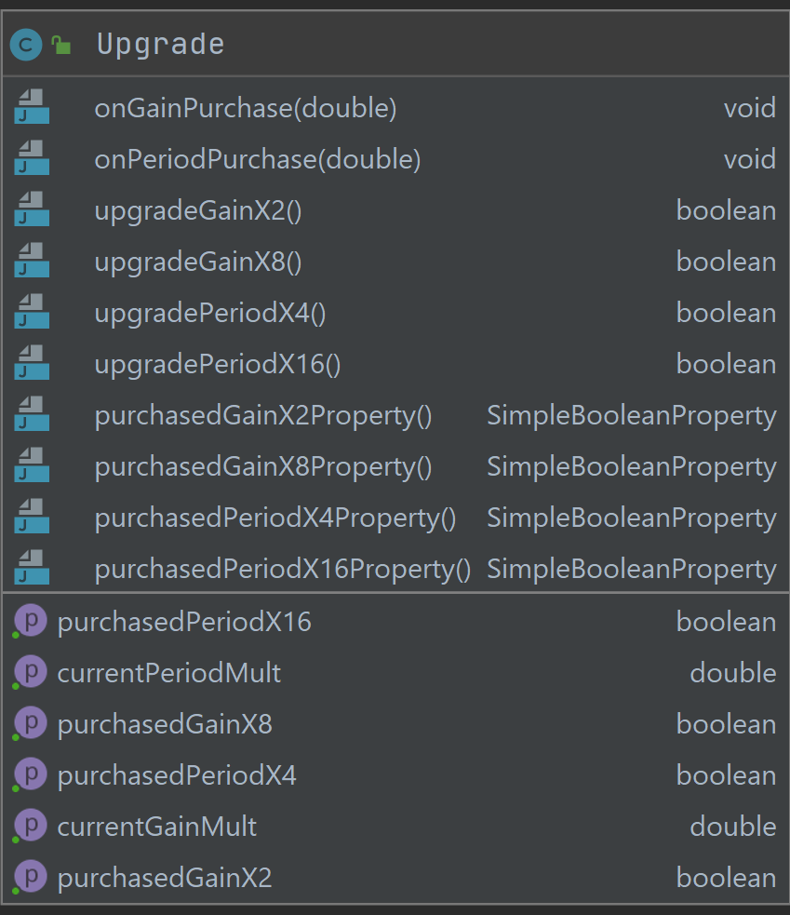
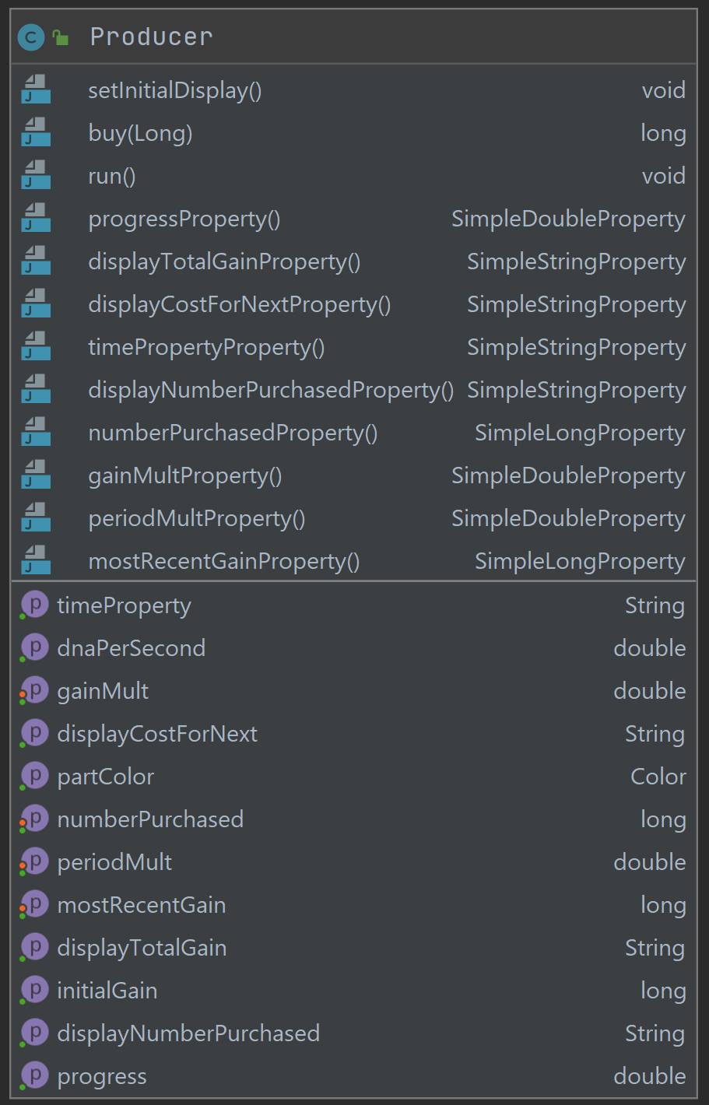
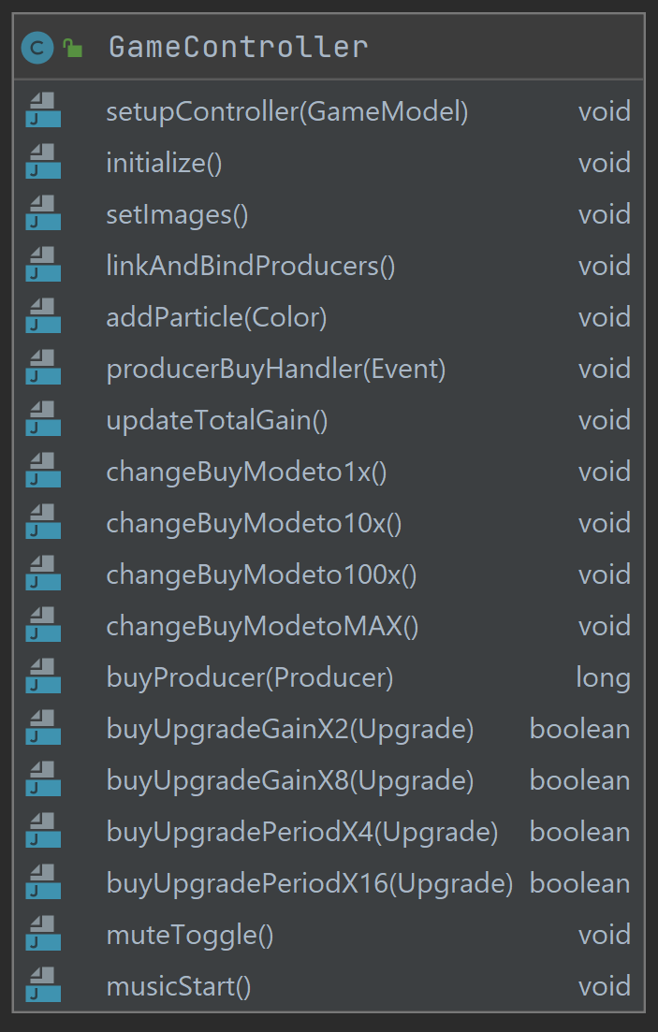
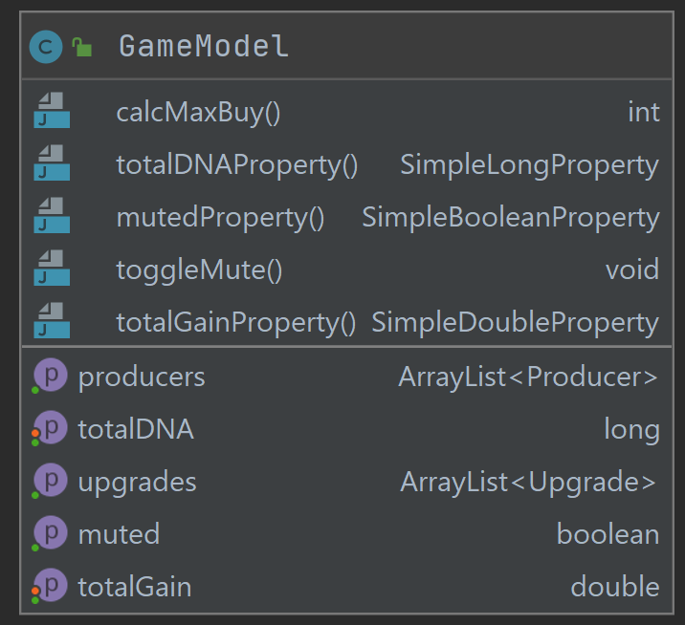
Our Major Classes
Notes:
The four most important classes of our program are producer, upgrade, game controller, and game model. The producer class serves as the outline for each producer with all of their properties and methods. Then, we instantiate each producer object into a list in the game model. The game model also sets up the GUI for the program. The model then works in the game controller class, serving as a holder for each producer. In the game controller is where we handle all of the buying functionality of the game. The DNA count, the ability to buy producers, the buy mode buttons, visuals, and even the music can all be attributed to the game controller class. Lastly, the upgrade class handles all of the upgrade buying for each producer.

Slide 7
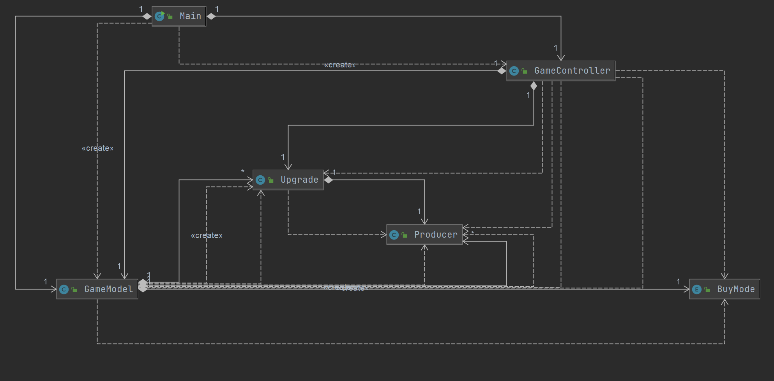
A Basic UML Diagram
Notes:
Our simple UML Diagram only consists of 6 classes. Our main class creates both the Game model and game controller class, ultimately starting the program.
The game model uses the upgrade and producer classes to house the producer objects.
The game controller class uses the game model and methods of its own to implement the actual functions of the game such as linking buttons to various methods.
Buy mode is an Enumeration that is used by the game controller to control how many of a producer are purchased when you press the buy button. It can be changed to 1, 10, and 100.
The producer class hold all of the producer attributes and methods. It is used extensively as each producer is created as an object and put into an array list.
The upgrade class is used to upgrade existing producers by changing their attributes. It is used in the game model to create the upgrades themselves whereas in the game controller it is used to purchase said upgrades.

Slide 8
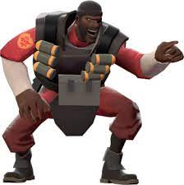
IT’S DEMO TIME!
Image from Wikipedia

Slide 9
Our Scrum Journey
Hard to follow
Probably Beneficial
Strengths
Outlined our work
Accountability
Challenges
Issues
Keeping up with sprints
Notes:
Scrum was not an easy process to follow however, we think it helped us in the long run.
Daily Scrum was a very tedious process but it helped us outline what each of us was doing every day and what was expected of us for the next meeting. For us, our Scrum gave us each deadlines to get portions of the program done while also holding each other accountable.
The hardest parts of following Scrum was remembering to create issues, spend time on issues, and staying on top of our sprints.

Slide 10
Git Issues
Couldn't push to git
Team couldn't access work
Took up valuable time
Stopped from advancing
Fix git issues at the start
Would have saved A LOT of time
Notes:
Git was a large holdup for our project. Even though work was completed on various issues, I was unable to push my workspace successfully which prevented my code from being accessible to my team.
I spent way too much time trying to fix this issue with git, and that pulled me from advancing the project in more productive ways. While it was important for me to fix this issue, I refused to just reset my git workspace and copy over work.
In short, a little bit of extra work earlier on for me would have saved a lot of time in the long run troubleshooting issues. Sometimes, it's better to scrap something thats not working and just re do the whole thing.

Slide 11
Moving Forward
What we would do differently:
Start smaller
More defined issues
Explain more
More meetings
Procrastinate less
Notes:
We feel that we had a good Scrum process for this project but we would still make a few small changes for any future agile projects we undertake
Start Smaller. Starting smaller and building in features afterwards would be a good way to ensure we get the basic framework done faster.
More defined issues. At the start, we would want to have more defined issues at the start so we wouldn't have to make new issues each meeting and have an even easier outline for team members to follow
Explain more. We would want to be more open about how we are solving issues and explain to our team mates what we did to solve each issue. This would make sure everyone is on the same page and give everyone the confidence that they know what everything does.
More Meetings. For this project we met every 2 days with few interruptions. In the future, we would want to meet every day to give everyone more opportunities to ask questions to the group as well as ensuring everyone is up to date and knows what their part is.
Procrastinate less. At the start of the project, we predicted that our biggest problem would be procrastination and we were somewhat right. Obviously, for future projects we would want to work on issue sooner giving us more time for more complicated features

Slide 12
Whats next for Covid Clicker 2.0?
Features:
Save game and offline learning functionality
Buy Max number of producers possible
Adding more upgrades that improve your producers in new, fun ways
Improve the look of the game for a more fun and appealing experience
Notes:
There were a lot of features that we came up with that didn’t quick make the cut for version 1.0, however given more time, our team would first implement a save game feature. This will allow you to exit the app, and start it up again without losing your progress and starting over. Additionally, we would build in offline functionality, so all of your busy producers can keep earning DNA for you when then app is closed! We also want to enable a max buy feature, so you can spend all of your DNA in one click to buy as many producers as possible, not just limiting it to 1, 10, and 100 at a time. Adding some additional upgrades for you to purchase is another thing we would like to add, such as increasing the production of all producers at once. Finally, we would take more time to make the game look, sound, and feel more interesting as you play it.

